Slide 1
Ice Arena Temperature Control
-Bhavy Bhut (810917417)
-Siddhi Shah (810933687)

Slide 2
Ice Arena Temperature Control
Abstract:
Focus on: Measuring Temperature and Humidity for Ice Arena, Kent State University .
If temperature and humidity force below pre-define limit ,it will give alert in form of SMS.
It gives real time visualization through Google Charts and Maps.

Slide 3
Ice Arena Temperature Control
In this project ,we mainly use two types of sensors.
One sensor is used to measure the Temperature and Humidity of outside’s weather.
Second sensor is used inside the Ice Arena to measure the Temperature and Humidity.
The Photo resistor gives idea about the day and night.

Slide 4
Ice Arena Temperature Control
DHT11 is used to measure inside and outside’s Temperature and Humidity of Ice Arena.
One wire is measure the Temperature of Ice.
All the sensor data is forwarded to centralize stream named ‘ice_arena’.
We have display the measured Temperature and Humidity through the Google chart and Map.

Slide 5
Ice Arena Temperature Control
If the either Temperature, Humidity or Ice temperature goes beyond the limit, it will gives alerts through the SMS.

Slide 6
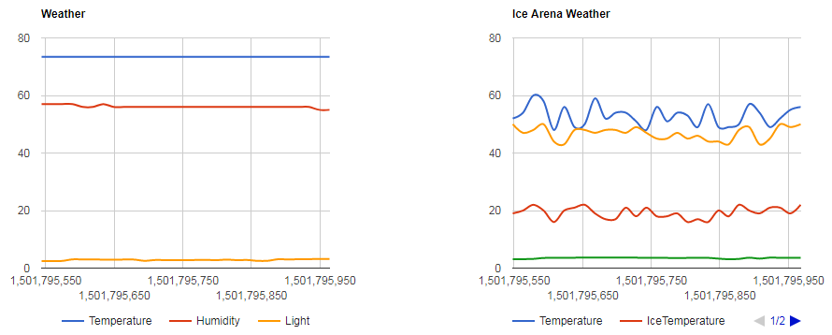
Ice Arena Temperature Control

Slide 7
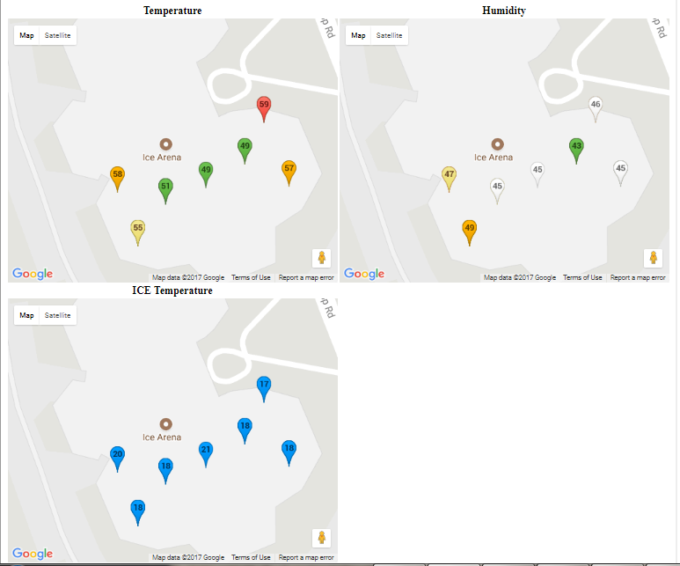
Ice Arena Temperature Control

Slide 8
Ice Arena Temperature Control
Future Work:
By using dew point and ice thickness sensor the performance of Ice Arena Temperature Control can be enhance.

